Slide 1
Group – 9
4BIS – 8 >> Su Myat Noe Yee
4BIS – 20 >> Myo Sandar Linn
4BIS – 25 >> Ingyin May
4BIS – 31 >> Thaw Tar Myo Nyunt

Slide 2
What is Configuration Management ?
Configuration management (CM) is a systems engineering process for establishing and maintaining consistency of a product's performance, functional, and physical attributes with its requirements, design, and operational information throughout its life.
Configuration management is also used in software development and deployment, where it is called software or unified configuration management (SCM or UCM).
Developers and others involved in the project can use SCM to keep track of artifacts, including source code, documentation, problems, changes requested and changes made.

Slide 3
Software configuration management provides structure to development steps, such as establishing baselines and reporting on the status of development processes.
Software configuration management tools, such as Chef and Puppet, can be used in concert with version-control tools for source code management, such as Apache Subversion and Git.

Slide 4
What is Configuration Management Tool ?
Configuration management tools are not strictly testing tools either, but good configuration management is critical for controlled testing.
It is really very important to know exactly what it is that we are supposed to test, such as the exact version of all of the things that belong in a system.
It is possible to perform configuration management activities without using the tools, but the tools make it a lot easier, especially in complex environments.

Slide 5
Features or characteristics of configuration management tools are:
To store information about versions and builds of the software and testware.
Traceability between software and testware and different versions or variants.
To keep track of which versions belong with which configurations (e.g. operating systems, libraries, browsers).
To build and release management.
Baselining (e.g. all the configuration items that make up a specific release).
Access control (checking in and out).

Slide 6
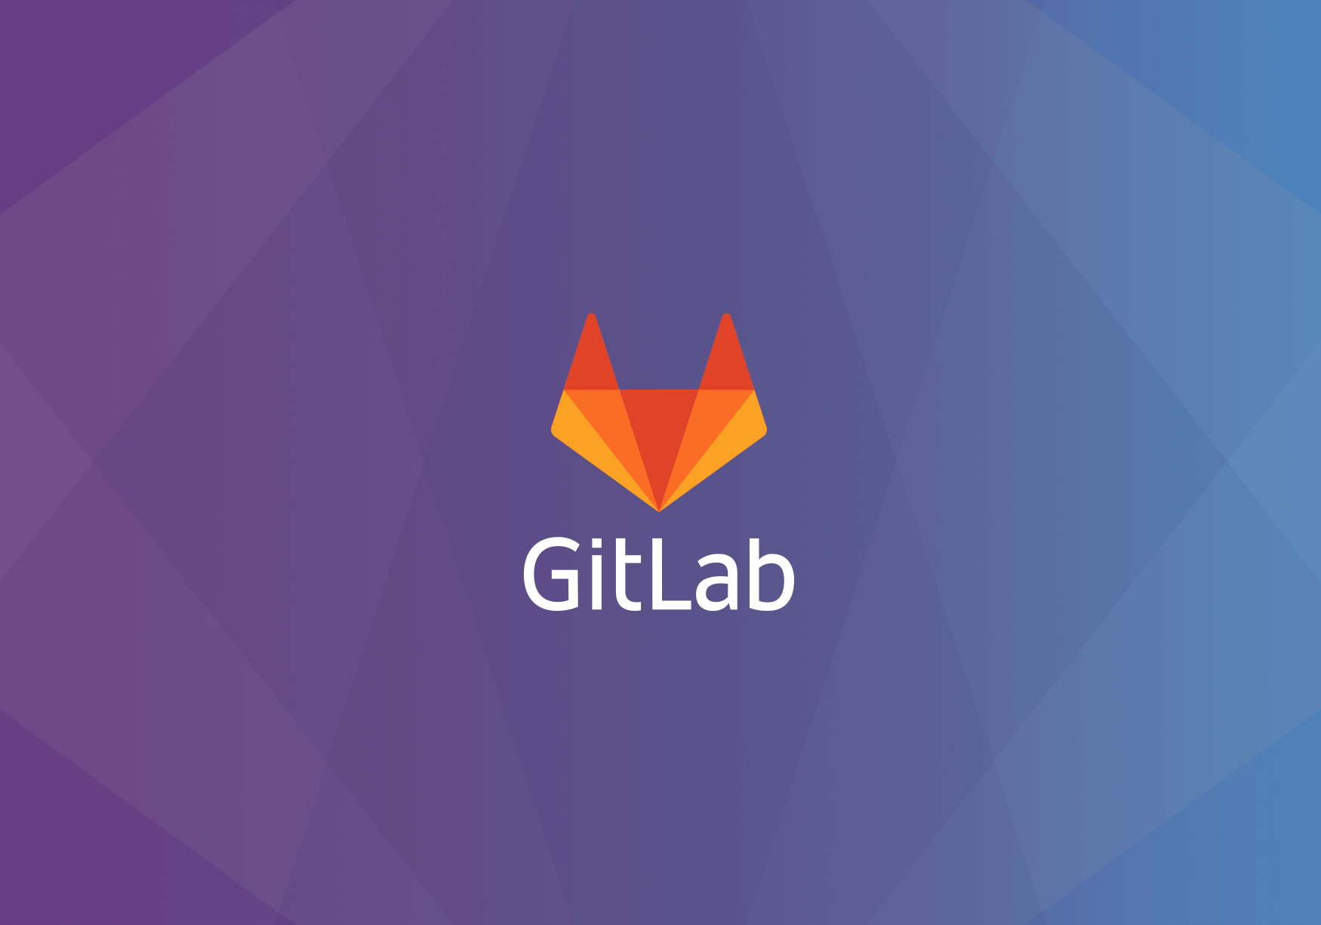

Slide 7
What Is GitLab ?
GitLab is based on Git, a powerful Version Control System tool.
GitLab is an online Github alternative with some unique features and a continuously evolving software.
GitLab is a web-based Git repository manager with issue tracking features, using an open source license, developed by GitLab Inc.
GitLab lets teams collaborate on code, duplicate code to safely create and edit new projects, then merge finished code into existing projects.
It has three separate versions: GitLab Community Edition (CE), Enterprise Edition (EE), and a GitLab-hosted version, GitLab.com.

Slide 8
Its permissions, branch protection, and authentication features are what really make it stand out.
Teams can secure projects on a more granular level, and projects are kept even safer while they’re being worked on.
If you have the opportunity to use it locally, you're able to make it public or private.
You can control individual, group and project permissions.
You can also have public and private projects.
Most of the features you might be used to on Github are available on GitLab.

Slide 9


Slide 10
Facilitates code review / quality control of changes
Simplified permissions and protections
Support 25,000 users on one server or a highly active cluster
Innovation : Monthly releases of new features and functionality
Open Source : MIT licensed, community driven, inspect and modify the source, easy to integrate to your infrastructure.

Slide 11


Slide 12
GitLab has everything GitHub has, and more—giving teams increased control over their repositories. Its extra features include:
A convenient user interface enables users to access everything from one screen: projects, latest projects, users, latest users, groups, and stats.
Settings allow users to control whether a repository is public or private.
Snippet support lets users share small pieces of code from a project, without sharing the whole project.
Protected branches are a new way to keep code safe. They allow users to set higher permissions on a project, so only certain people are able to push, force push, or delete code in a branch.

Slide 13
Authentication levels take this security a step further, allowing users to give people access beyond a read/write level. For example, you can give a team member access to issue tracking without having to give them access to the code itself.
Improved milestones enable you to set milestones at a group level, not just a developer-specific level. Developers can get insight into the whole team’s scope and view the entire project’s milestones, not just their own.
With the “Work in Progress” status, developers can label a project “WIP” to let collaborators know that the code is unfinished. This prevents it from accidentally getting merged with other code before it’s finished.
You can attach files like comments to any communications in GitLab.

Slide 14


Slide 15
What do you dislike?
The biggest disadvantage of GitLab is probably it's speed.
It's not slow but it would be nice if it was faster.
Also it would be useful if it could import SVN repositories too.

Slide 16

Thank You

